Slide 1
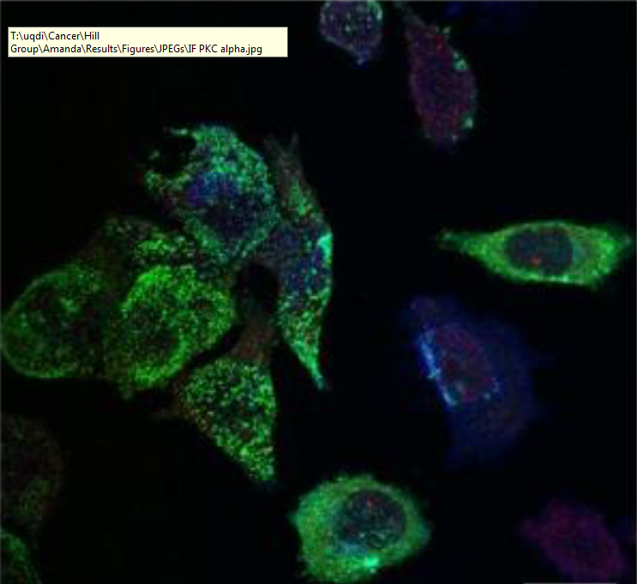
Selective export of microRNA via extracellular vesicles
Harley Robinson
Supervisor: Dr Michelle Hill
Co-supervisor: Dr Alex Cristino

Slide 2
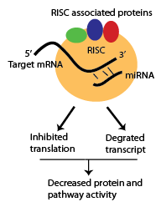
microRNAs
Important for regulatory mechanisms.
Binding to target mRNA decreases protein function by RISC inhibition and degradation
Export of microRNAs (miRs) regulates pathways in the recipient cells attributed to:
Cardiac homeostasis
Diabetes
Cancer metastasis
Notes:
RISC- RNA induced silencing complex.
Risc associated proteins: argonates, Dicer,

Slide 3
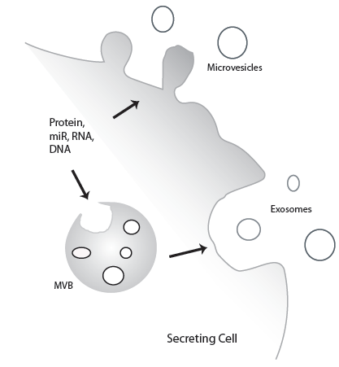
Extracellular vesicles
Composed of microvesicles and exosomes.
Content regulate processes in recipient cells.
Surface contains homing proteins to allow for
cell specific delivery
Important for intercellular communication.

Slide 4
Current Cargo Loading Mechanisms.
Protein loading mechanisms:
-Well characterised
- ESCRT complex
- Tetraspanins
MicroRNAs:
- Little information known regarding sorting.
-Sumoylated hnRNP A2B1

Slide 5
Advanced Prostate Cancer Cell Line: PC3
Increased Caveolin-1 expression, without Cavins.
Caveolin-1 is a cholesterol transporter
When accompanied by Cavin-1, it will form
caveolae, required for Endocytosis.
Caveolin-1 is a proposed biomarker for cancer.

Slide 6
Cavins and lipid rafts
Introduction of Cavin-1 results in modulated
cholesterol re-distribution, EV protein content and miR content.

Slide 7
Hypotheses and Aims:
We hypothesise that the introduction of Cavin-1 to a PC3 model will modify the EV miR content due to a modification of RNA binding protein.
Aims:
- Identify the miRs that are selectively exported
- Identify RNA-binding proteins correlated to the miR export
- Verify candidate miR escort proteins ability to bind to miRs and transport to EVs.

Slide 8
Aim 1: Analysis of miRNA export
Method 1: Bioinformatic Analysis.
Previous miRNA-seq data compiled for cell and EV fraction of PC3 GFP cells and PC3 cavin-1 transfected cells.
Using R packages to find fold change differences between Cavin-1 and GFP
Compare cavin-1 vs GFP between cell and EV to find differentially exported miRs.

Slide 9
Aim 1: Analysis of miRNA export. Cont.
Method 2: RT-qPCR

Slide 10
Aim 2: Identify candidate miR binding proteins.
Method 1: Computational analysis.
Previous proteomics data collected for the lipid raft, plasma membrane, EVs and total secretome

Slide 11
Aim 2: cont.
Method 2: Motif discovery.

Slide 12
Aim 3: verification of miR Candidate.
Method 1: Pull down assay

Slide 13
Aim 3: Cont.
Method 2: Co-localisation by Immunofluorescence Confocal Microscopy

Slide 14
Significance: Cancer

